Slide 1

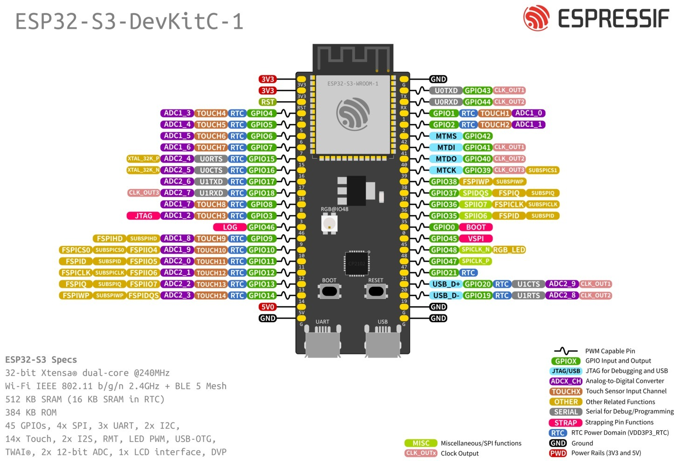


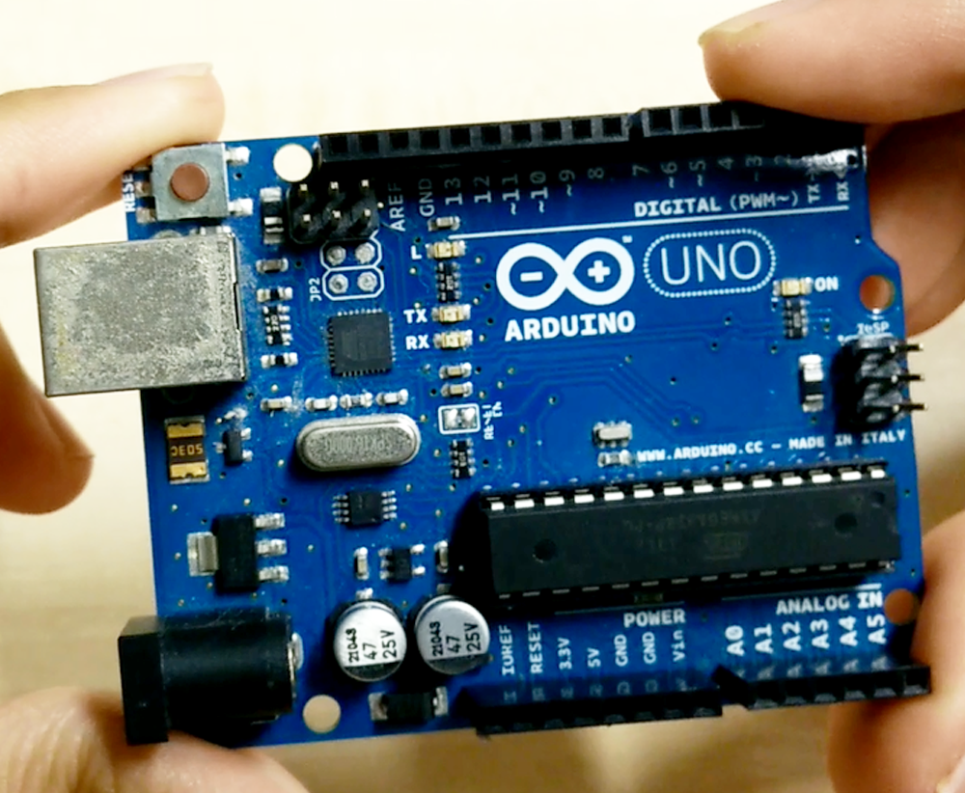
JANUARY 8
Embedded Systems - Brief Teach Back
Contributor
Daryl Jimenez-Cascante

Slide 2





Daryl J.
Company Overview
What is the technology - what is embedded systems?
Embedded systems intertwines both software and hardware, creating systems that reach toward a larger goal. More specifically, it is the mechanical combining with the digital (i.e. digital clocks, industrial machines, and medical equipment).
Company Name

Slide 3
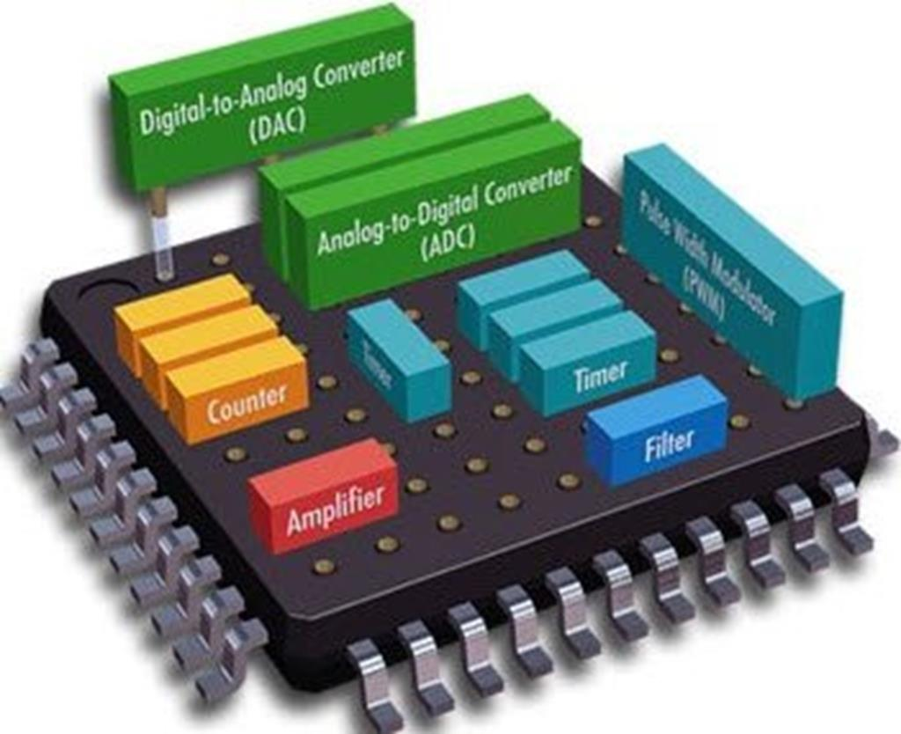
Daryl J.
Company Overview
What does the technology do - what does embedded systems do?
Embedded systems is responsible for systems that accomplish a specific task efficiently (or so compared to a human being). It simplifies life for the manufacturer, the farmer, the school teacher, the programmer, and the scientist
It is responsible for the growth of industries such as aerospace, healthcare, travel, and is even present in domestic appliances. We owe it to this technology many of our life’s conveniences.
Company Name

Slide 4
Why is it important to develop this track?
Roadmap
Once dangerous tasks can be reduced to things that can be done from the comfort of one's home, such as piloting drones to look through uncharted terrain.
Thanks to advancements in microcontroller technology, manufacturability and the associated cost has been drastically reduced. This has allowed the technology to touch ground in areas unforeseen.
Why is it important to develop embedded systems?
Company Name

Slide 5
Daryl J.
Company Overview
What are some good resources for this - what are some good resources for embedded systems?
https://docs.espressif.com/projects/esp-idf/en/latest/esp32/index.html - High-demand microcontroller chip (ESP-32) documentation for software management
https://docs.arduino.cc/learn/ - The entryway for microcontroller programming through Arduino
Company Name

